Slide 1



Corporate Presentation
Nasdaq CPIX

Slide 2

Safe Harbor
Statement
This presentation contains forward-looking statements concerning our approved products and product development, our technology, our competitors, our intellectual property, our financial condition and our plans for research and development programs that involve risks, uncertainties and assumptions. These statements are based on the current estimates and assumptions of the management of Cumberland Pharmaceuticals as of the date of this presentation and are subject to uncertainty and changes in circumstances. Given these uncertainties, you should not place undue reliance upon these forward-looking statements. Such forward-looking statements are subject to risks, uncertainties, assumptions and other factors that may cause the actual results of Cumberland Pharmaceuticals to be materially different from those reflected in such forward-looking statements. | Important factors that could cause actual results to differ materially from those indicated by such forward-looking statements include, among others, those set forth under the headings "Risk factors" and "Management's discussion and analysis of financial condition and results of operations" in our Form 10-K and Form 10-Q Reports on file with the SEC. The Company does not undertake any obligation to release publicly any revisions to these forward-looking statements to reflect events or circumstances after the date hereof or to reflect the occurrence of unanticipated events. All statements contained in this presentation are made only as of the date of this presentation. For more information on our brands, including full prescribing and safety information, please see the links to the product websites which can be found at www.cumberlandpharma.com.
2

Slide 3
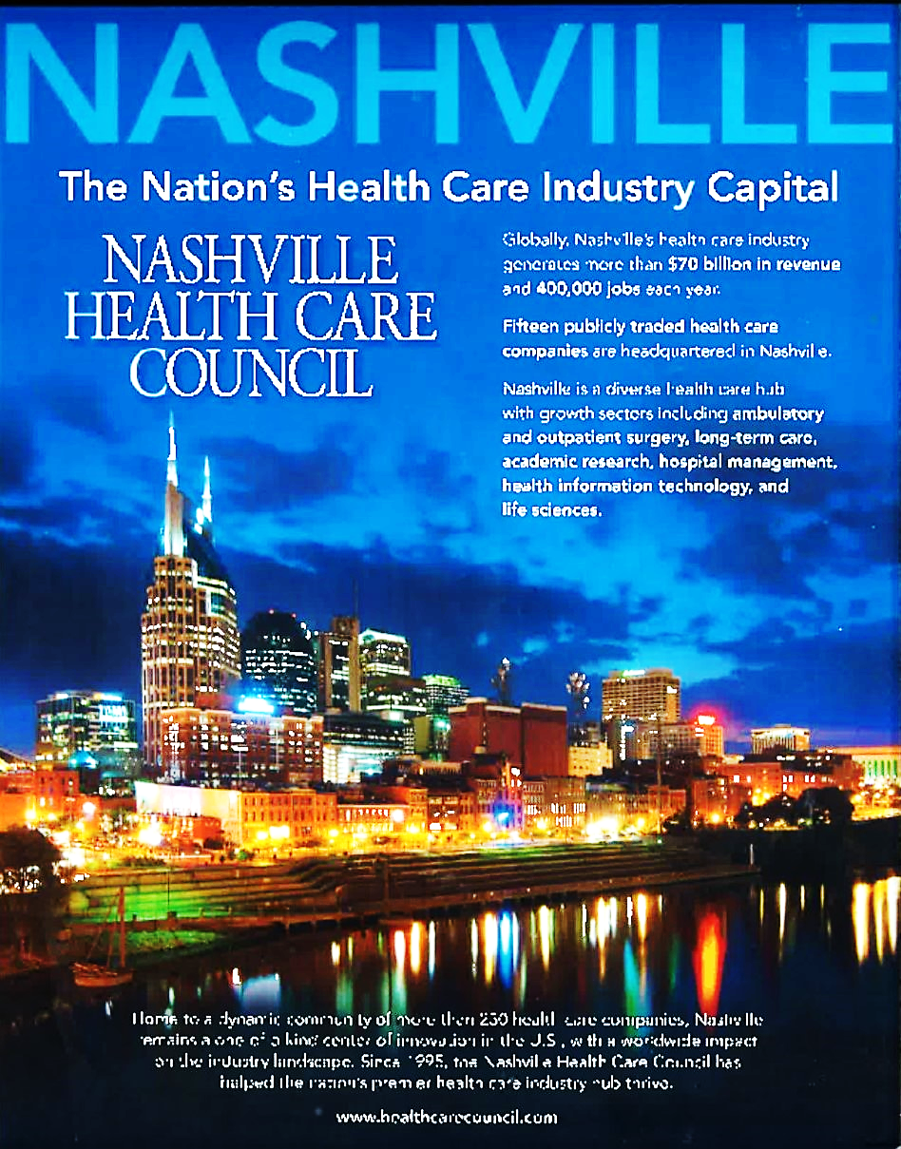
Nation’s
Health Care Capital
3

Slide 4

Company Overview
Specialty pharmaceutical company
  Portfolio of FDA approved branded products
  Promoted by three national sales divisions
Several catalysts for new growth opportunities
  Sancuso® post-acquisition integration and market expansion
  Next Generation Caldolor ® product with expanded labeling
  Vibativ ® acute care, out-patient and international initiatives
Phase II candidates in development with study results milestones
Proven record of successful product development and product acquisition
4

Slide 5

Mission & Strategy
Mission: Working together to provide unique products
that improve the quality of patient care
Strategy: We are building a portfolio of
specialized biopharmaceutical brands
5

Slide 6



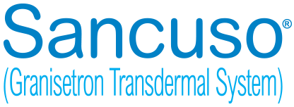
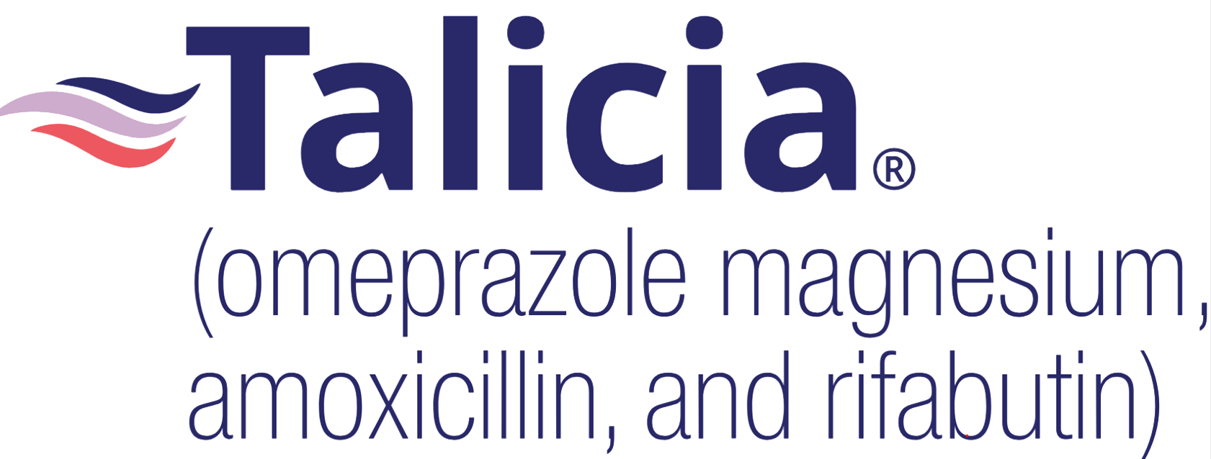
Product Portfolio
Product
Development:
Product
Acquisition:
6

Slide 7
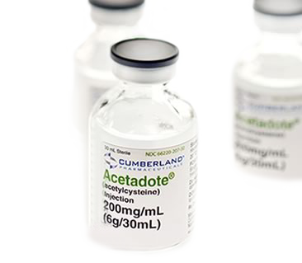
IV treatment for America’s leading cause of poisoning
Treats liver toxicity associated with acetaminophen overdose
Acetadote (IV N-Acetylcysteine) developed and registered by Cumberland
IV N-Acetycysteine now standard of care
Cumberland developed unique EDTA free formulation
New dosing regimen approved with FDA exclusivity
*National Poison Data System, American Association of Poison Centers
7

Slide 8
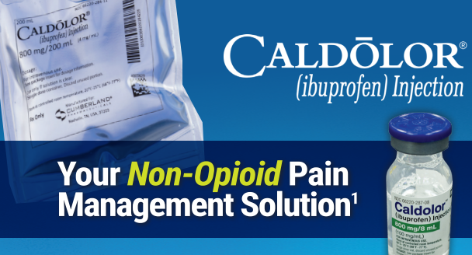


Slide 9
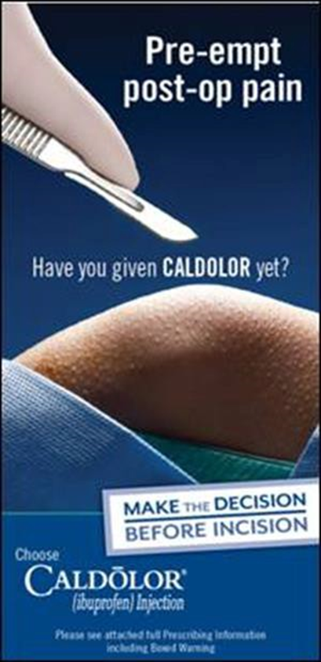
Injectable delivery of ibuprofen
Developed and registered by Cumberland
Antipyretic, analgesic & anti-inflammatory properties
Evaluated in published studies with ~ 2,000 patients
Approved for use in adults, children and newborns
Prior to surgery administration approved by FDA
New data with favorable comparison to ketorolac
Recent publication featuring profile in geriatric patients
*
9

Slide 10



Slide 11
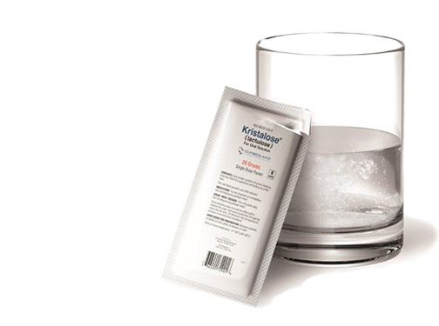
Unique crystalline formulation of lactulose
Prescription strength laxative
Clinically proven increase in patient satisfaction
Featured in award winning marketing campaign
Supported by key co-promotion partners
New initiatives underway to protect and grow business
11

Slide 12
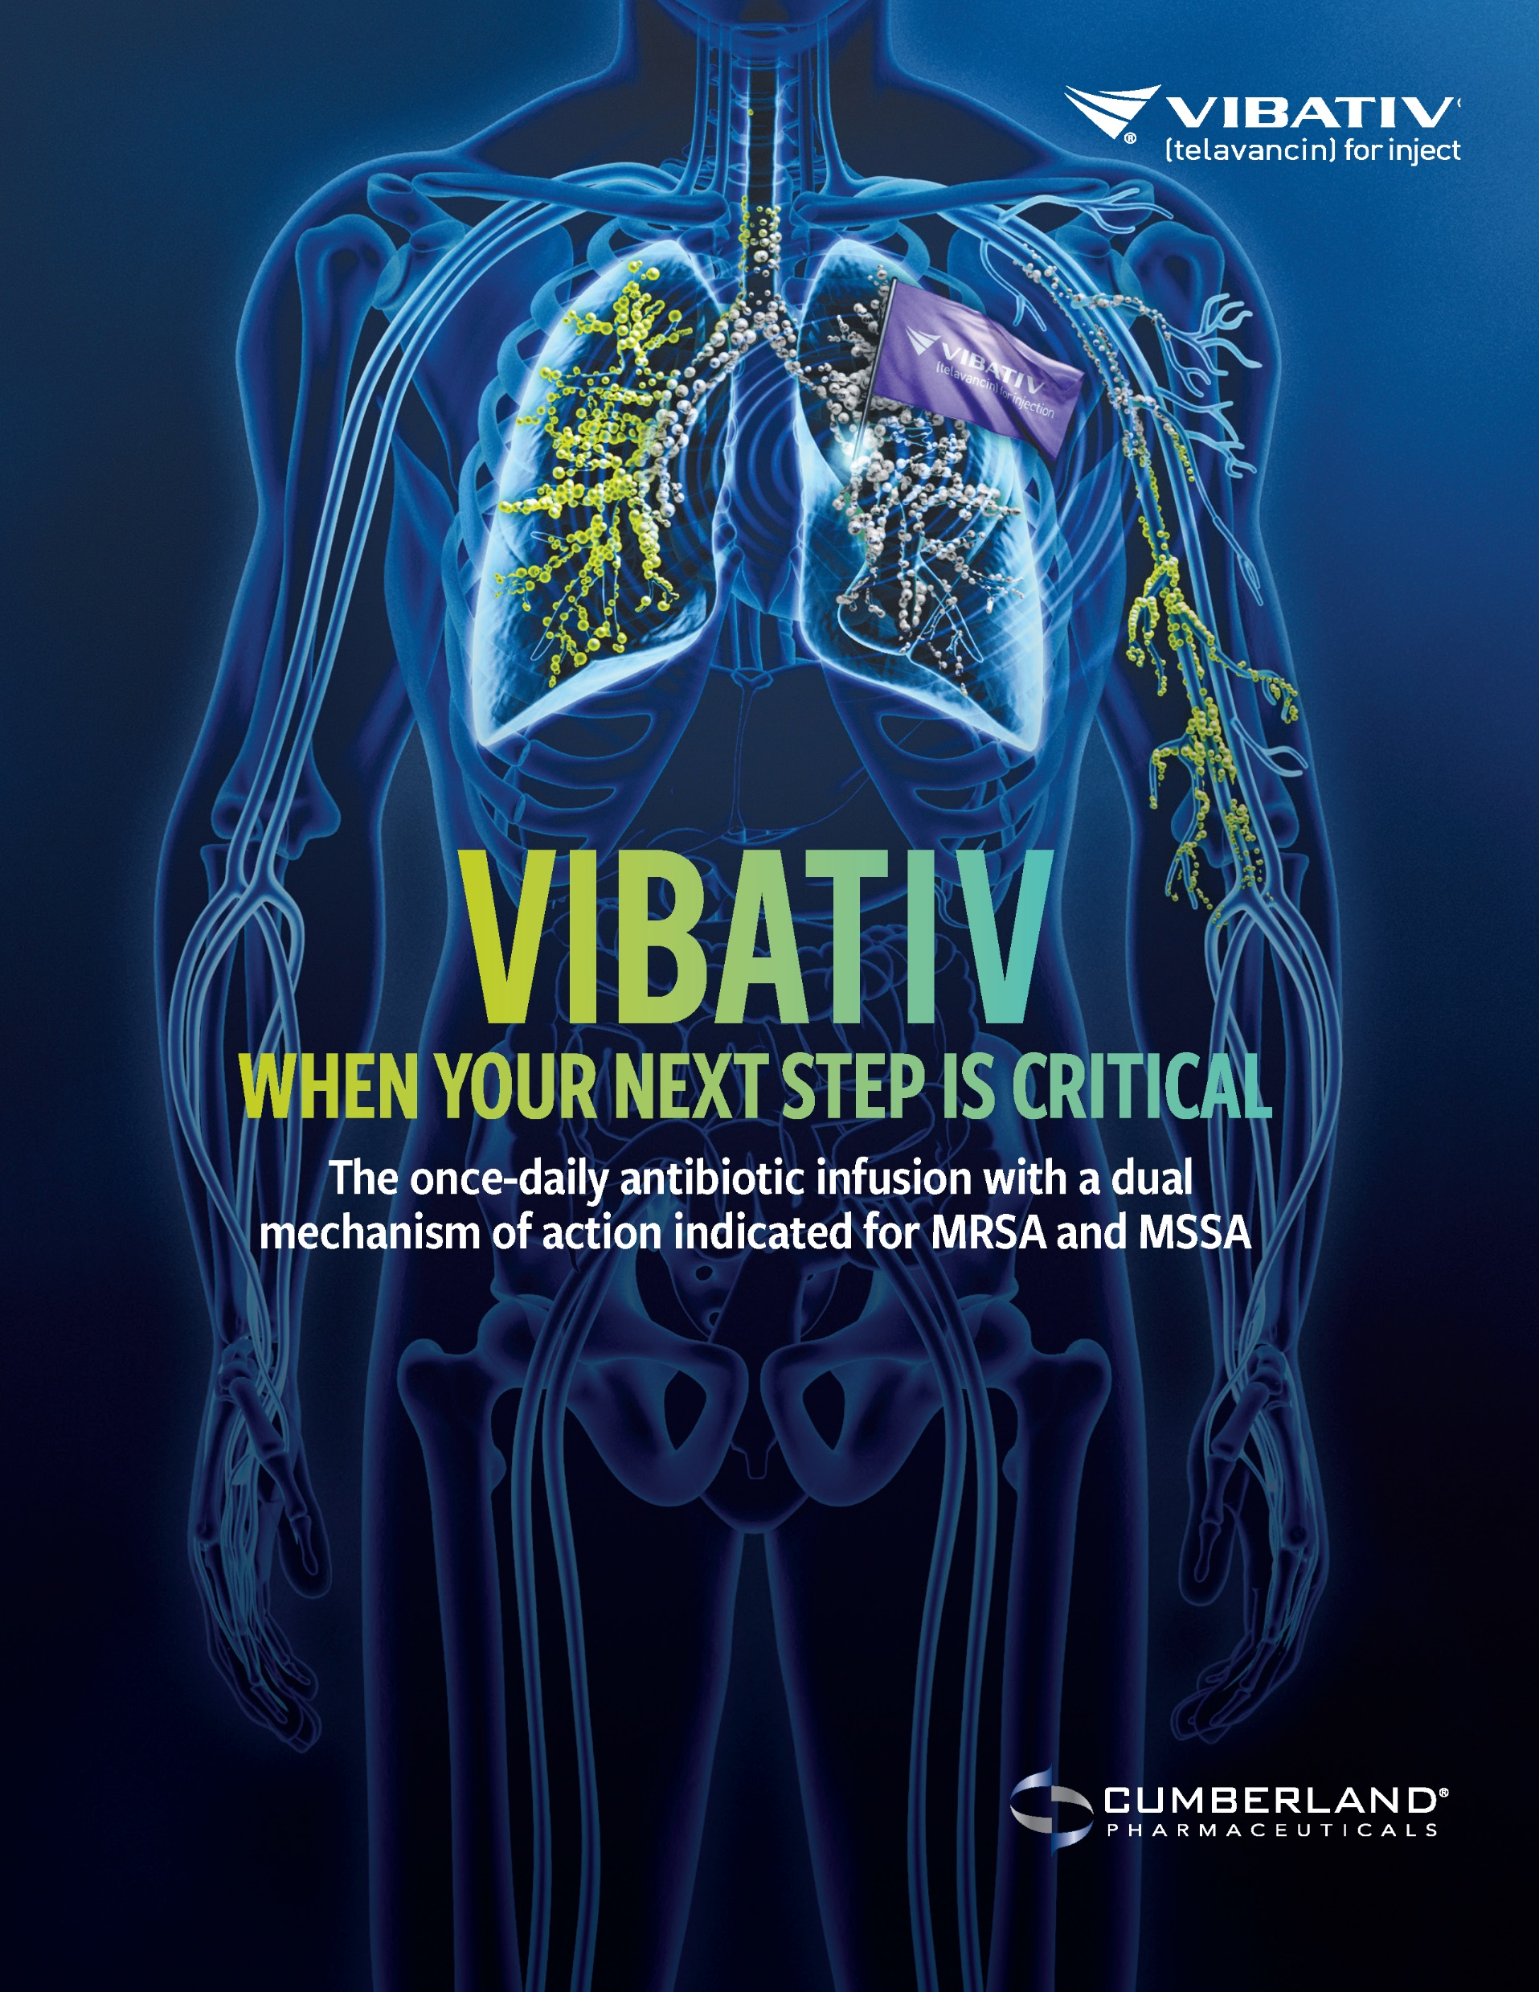

Slide 13

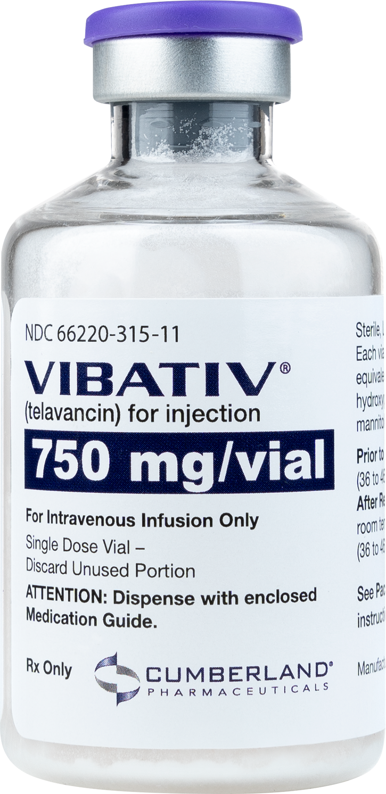
IV antibiotic that treats life-threatening infections
Potent treatment for pneumonia and serious skin infections
resulting from gram positive bacteria
Used in hospital acute care and out-patient center settings
Unique ability to penetrate tissues
Product features favorable resistance profile
Growing international approvals and opportunity
13

Slide 14
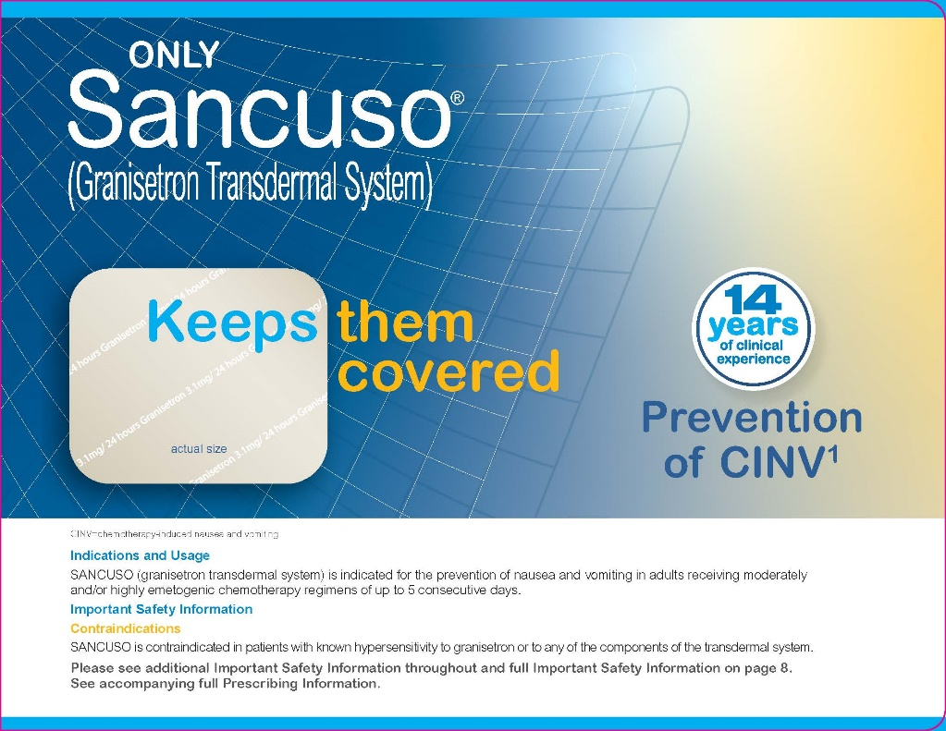
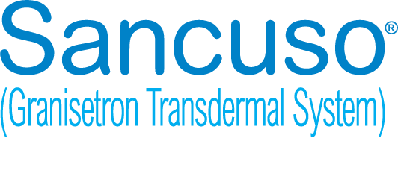
14

Slide 15
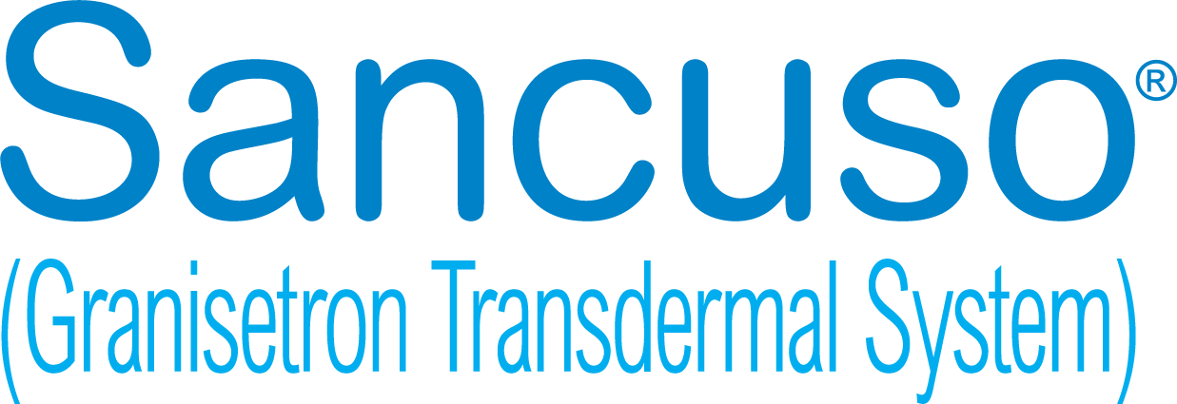

FDA-approved transdermal system for chemotherapy-induced nausea and vomiting
Patch that slowly releases medicine into bloodstream
Designed to prevent nausea and vomiting in adults to help tolerate certain chemotherapy treatments
Medicine delivered over five consecutive days
compared with multiple daily dosing for oral alternatives
Supported by expanded oncology sales division
15

Slide 16


Slide 17
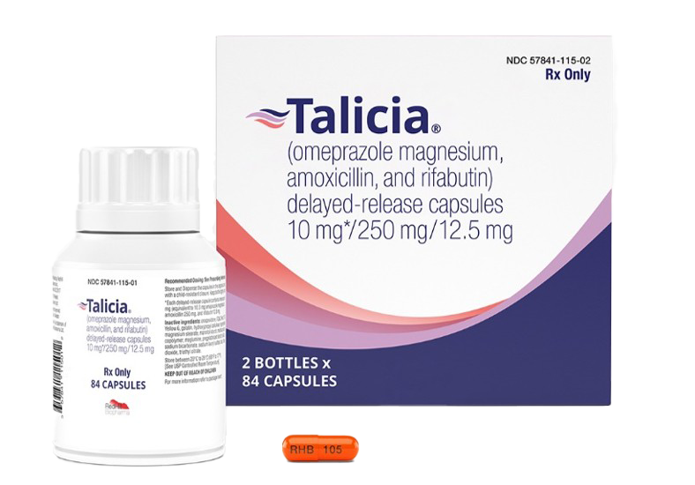
FDA-approved oral capsule for the treatment of Helicobacter pylori (H. pylori) infection in adults, a bacterial infection of the stomach and leading risk factor for gastric cancer
A fixed-dose, all-in-one capsule combination of two antibiotics, amoxicillin and rifabutin, and a proton pump inhibitor, omeprazole
Patented, and a first line treatment
17

Slide 18

Ifetroban
Overview
Cumberland’s first new chemical entity
A potent, selective antagonist of thromboxane receptor
Discovered and initially developed by Bristol-Myers Squibb
Safety well-established in 30 clinical studies with over 1,400 subjects
Collaborating with Vanderbilt, Harvard, Scripps and other academic centers
Successfully manufactured both IV and oral formulations
18

Slide 19
Ifetroban
Development Pipeline
Preclinical
IND
Phase I
NDA
Phase II
Phase III
Dyscorban ® (Duchenne muscular dystrophy)
Vasculan ® (Systemic sclerosis)
Fibroban ® (Idiopathic Pulmonary Fibrosis)
19

Slide 20
Duchenne Muscular Dystrophy (DMD)
A rare, fatal, neuromuscular disease with the progressive loss of muscle resulting in deterioration of the skeleton, heart and lungs
Cumberland is investigating ifetroban for the treatment of cardiomyopathy
that is associated with DMD
Preclinical data demonstrates ifetroban could prevent cardiac fibrosis and improve cardiac function – published Journal American Heart Association
The FDA has awarded over $1 million in Orphan Drug Grant funding
Orphan Drug and Rare Pediatric Disease Designations approved
Phase II study completed with breakthrough results announced
Fast Track Designation also approved!
20

Slide 21
Systemic Sclerosis (SSc)
Debilitating, chronic autoimmune disease causing
thickening of the skin and fibrosis of internal organs
Highest death rate of any rheumatic condition
Average survival is approximately 11 years from diagnosis
Women more commonly affected; also occurs in children
No FDA approved treatment for this unmet medical need
Phase II study enrollment completed
Top line study results to be reported next
21

Slide 22
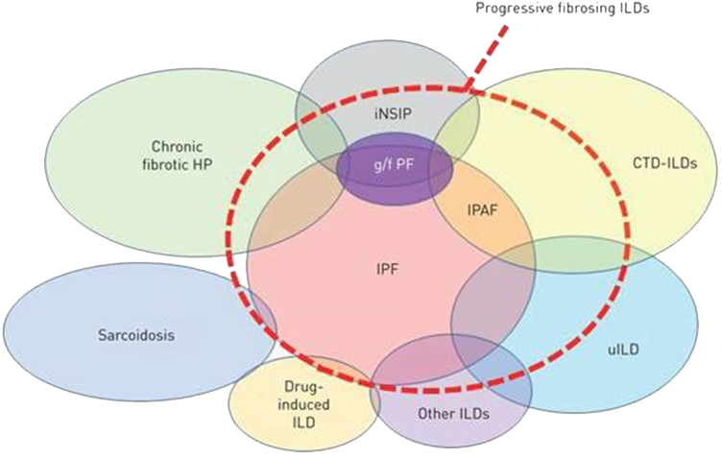
Fibroban® in IPF
Progressive Fibrosing Interstitial Lung Diseases (PF-ILDs) are a group of disorders that causes irreversible scarring (fibrosis) of lung tissue that leads to lung function decline and early mortality
Idiopathic Pulmonary Fibrosis (IPF) is the most common form of PF-ILDs
Orphan disease
IND cleared and Phase II study is well underway
22

Slide 23
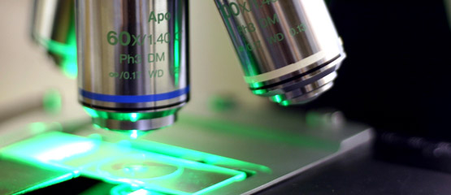


Slide 24
Joint initiative to build long term pipeline
Collaborating with Academic Research Partners
Building portfolio of innovative biopharmaceutical candidates
Supporting product development through grant initiatives
Managing Nashville’s Life Science Center
Houses Cumberland’s formulation and testing laboratories
24

Slide 25


Building a Diversified Product Portfolio
Ifetroban
Next Gen
In-Line Brands
Deploying a Multifaceted Strategy to Create Value
25

Slide 26
Commercial Portfolio Expansion Strategy
EXPAND
Existing Products
DEVELOP
Early-Stage Candidates
PRODUCT
PORTFOLIO
IDENTIFY
Late Stage Candidates
ACQUIRE
Under-Promoted,
Approved Brands
26

Slide 27

Acquisition Initiative
Active, ongoing initiative to identify, evaluate and acquire/license new products into the portfolio
Source opportunities through direct efforts and intermediaries
GOAL TO ADD ONE NEW PRODUCT PER YEAR
through business development initiative or internal product
development
Seek commercial and late stage development assets that ﬁt our strategy and focus
Branded, Rx products in hospital acute care gastroenterology or oncology
Sales of $5-25 million with attractive margins and differentiated features
27

Slide 28
Income Statement
($ IN MILLIONS) | FY 2025
Net Revenues | $ 44.5
Cost of Products Sold | 6.7
Gross Profit | 37.8
Selling & Marketing | 19.1
Research & Development | 5.6
General Administrative | 11.6
Amortization | 4.0
Adjusted Earnings | 2.1
Cash flow from operations | 4.9
28
28

Slide 29
Summary
Balance Sheet
($ in millions) | Dec 31, 2025
Cash and Securities | $11
Total Assets | 77
Total Liabilities | 52
Total Equity | 25
Total Liabilities and Equity | $77
*tax carryforward credits of $54 million available
29
29

Slide 30




Cumberland
Moving Forward
Diverse product portfolio of FDA approved brands
Proven development and commercialization capabilities
Various initiatives in place to support near-term growth
Phase II products in development with study results milestones
Valuation gap given level of sales, assets, infrastructure and pipeline
30

Slide 31

NASDAQ: CPIX

